Slide 1
INNOVATION AND ENTREPREUNERSHIP UNIT
INTERNATIONAL HELLENIC UNIVERSITY

Slide 2
MISSION
The active promotion of the Entrepreneurial spirit and conception, as well as the cultivation of the Innovation culture to students and graduates of the International Hellenic University

Slide 3
SCOPE AND AIMS
Assist students & alumni in discovering and chasing entrepreneurial opportunities
Ensure close cooperation between the university and the business community
Build a broad network of mentors and partners
Organisation of events and competitions on Innovation and Entrepreneurship
Creation of workshops with the ability of e-simulation of business operation
Preparation educational material & support the entrepreneurship course
Partnerships and synergies with the I&E Units of other universities, with public agencies such Chambers of Commerce, Local Councils et al as well as the establishment of international partnerships

Slide 4
SERVICES
Mentoring: Individual counseling and guidance services for the creation of new businesses
Student Resources: Providing specialized guides and tools as well as new methods for encouraging and informing prospective startups
Teaching: Support of the second semester optional course on innovation and entrepreneurship
Contacts & Networking: Support of start ups to establish contacts and synergies with other companies, research centers and institutions.
Company visits: Visits to organizations, production entities and companies that represent examples of successful innovative and entrepreneurial performance
Events and holding of competitions: which allow the promotion of entrepreneurial and innovative ideas of University’s students and alumni.

Slide 5
Mentoring
E-mail
Innovation & Entrepreneurship Course
Contact Form
Company Visit
Student or Alumni
Phone
Events
In person
Seminars/Workshops
Ennovation Competition

Slide 6
1. MENTORING
Provision of targeted counselling and mentoring services to students and Alumni of International Hellenic University
Creation of a network with business mentors for the provision of coherent services
Access to sources of business guidance and support
Organisation of seminars on entrepreneurship
Organisation of workshops

Slide 7
2. STUDENT RESOURCES
The Innovation and Entrepreneurship Unit can offer to students and alumni of I.H.U..:
Templates and tools for drafting a Business Plan
Alternative business tools such as Lean Canvas and Startup Economics
List with the most important sources of funding for start ups, Accelerators – Seed Capital Funds
Useful information and information material for a coherent support of your new entrepreunership step

Slide 8
Lean Camvas
Business Game
Startup Economics Beta
Innovation flowchart
Business plan templates
Accelerators - Seed Capital Funds
http://ecs.ihu.edu.gr/inn/resources/
ΜΟΝΑΔΑ ΚΑΙΝΟΤΟΜΙΑΣ ΚΑΙ ΕΠΙΧΕΙΡΗΜΑΤΙΚΟΤΗΤΑΣ (Μ.Ο.Κ.Ε.)

Slide 9
3. TEACHING
The I&E Unit supports the second semester optional course on Innovation and Entrepreunership.
Provision of e-course through the Unit’s website
Support of seminars and workshops with learning material.

Slide 10
The course is open to all
students of International
Hellenic University
ΜΟΝΑΔΑ ΚΑΙΝΟΤΟΜΙΑΣ ΚΑΙ ΕΠΙΧΕΙΡΗΜΑΤΙΚΟΤΗΤΑΣ (Μ.Ο.Κ.Ε.)

Slide 11
4. CONTACTS & NETWORKING
Our Unit managed to open channels of communication with important Greek and International companies

Slide 12
5. COMPANY VISITS
Each year the Innovation and Entrepreunership Unit is organising visits to the biggest companies of N. Greece, aiming to make students familiar with the business community and the establishment of foundations for later synergies and business initiatives.

Slide 13
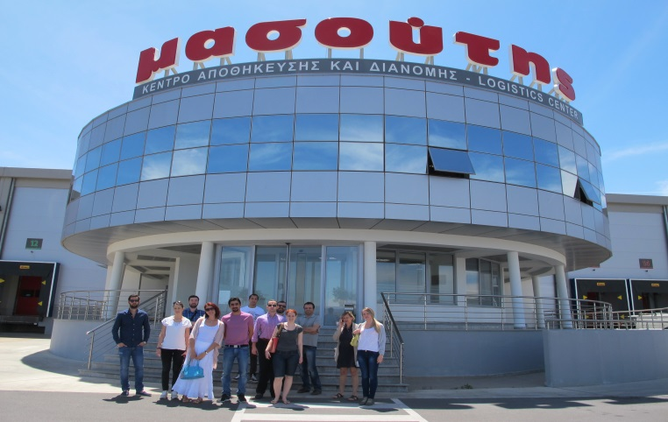
MASOUTIS S.A. (Μay 2015)
Agrivitex Energy S.A.
(May 2013)

Slide 14
6. EVENTS & COMPETITIONS ORGANISATION
I&E Unit is co-organising, along with the Economic University of Athens and the University of Nicosia of the Ennovation competition.
Annual organisation of the Innovation Days

Slide 15
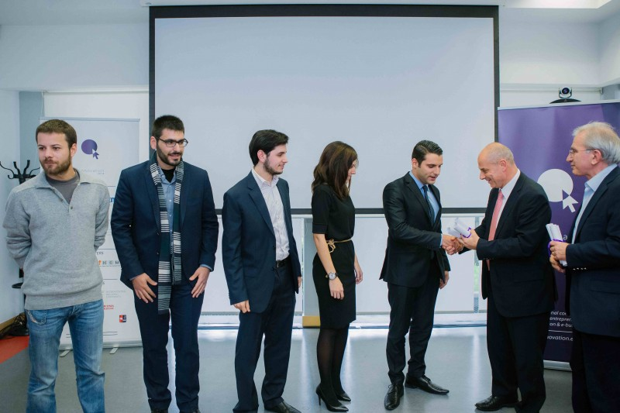
Currently the competition is on its 3rd stage and the award is 15.000€

Slide 16
For four days, the youth in Thessaloniki it has
the opportunity to attend consultative work of
the students from the International Hellenic University with companies, presentations from successful start-ups, tools for financial innovation, profiles of major innovation competitions and presentations of the real success stories of the Greek economy by speakers from Greece and abroad
www.innovationdays.gr
ΜΟΝΑΔΑ ΚΑΙΝΟΤΟΜΙΑΣ ΚΑΙ ΕΠΙΧΕΙΡΗΜΑΤΙΚΟΤΗΤΑΣ (Μ.Ο.Κ.Ε.)

Slide 17
WHERE YOU WILL FIND US
http://ecs.ihu.edu.gr/
Tel. 2310 807574
E-mail. F.mavromatidis@ihu.edu.gr
ΜΟΝΑΔΑ ΚΑΙΝΟΤΟΜΙΑΣ ΚΑΙ ΕΠΙΧΕΙΡΗΜΑΤΙΚΟΤΗΤΑΣ (Μ.Ο.Κ.Ε.)

Slide 18
THANK YOU FOR YOUR ATTENDANCE
ΜΟΝΑΔΑ ΚΑΙΝΟΤΟΜΙΑΣ ΚΑΙ ΕΠΙΧΕΙΡΗΜΑΤΙΚΟΤΗΤΑΣ (Μ.Ο.Κ.Ε.)

